Slide 1
Boosting Algorithm
Assignment

Slide 2
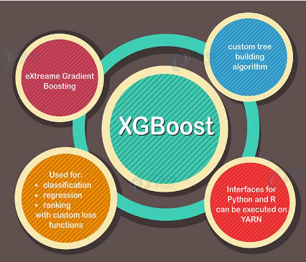
XGBoost
- Focuses on computation speed and model performance

Slide 3
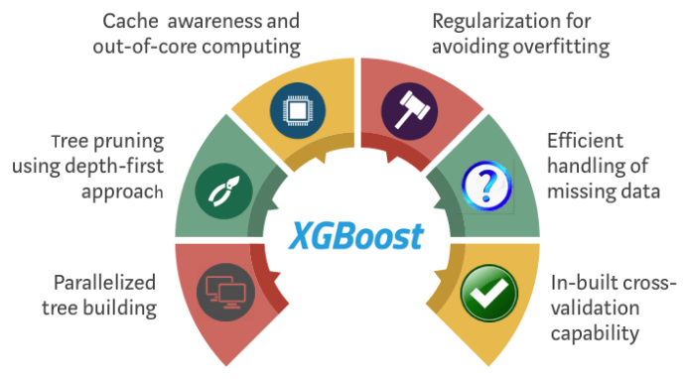
XGBoost
- Can be used for both regression and classification tasks and has been designed to work with large and complicated datasets

Slide 4
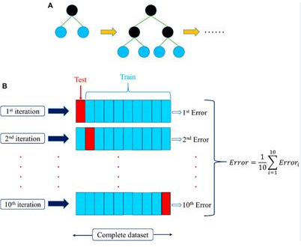
XGBoost

Slide 5
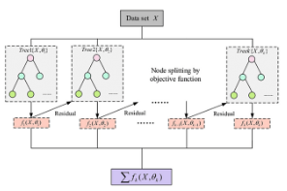
XGBoost

